Slide 1
Embedded Electronic Systems final project
Motion Map

Slide 2
Project statement
Read the IMU in a loop for 15 seconds
Save data every 100 ms while moving the Pi!
Get the average execution time of the readings!
Draw a map in a GUI about the path the Pi has been moved and its orientation along its path!

Slide 3

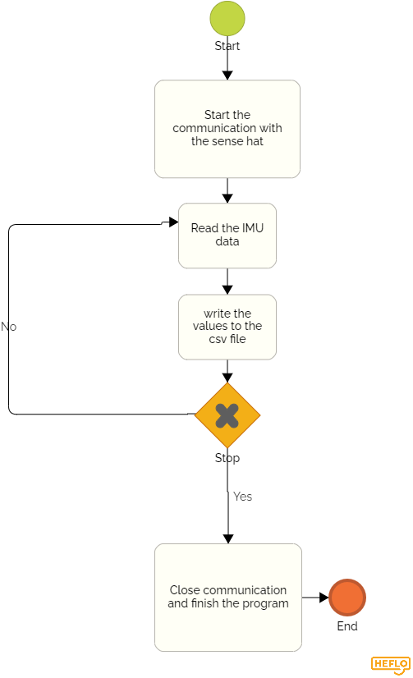

Datalogger script
Based on https://github.com/raspberrypilearning/sense-hat-data-logger

Slide 4
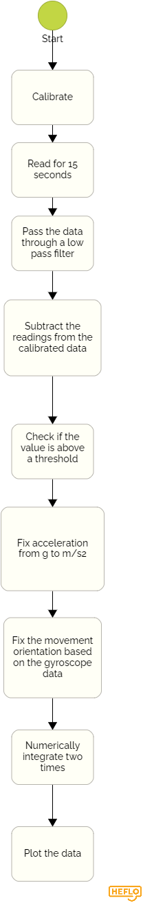
Algorithm developed
Calibrates for baseline
Uses low-pass filter to smooth noise from readings
Uses the trapezoid method of integration

Slide 5
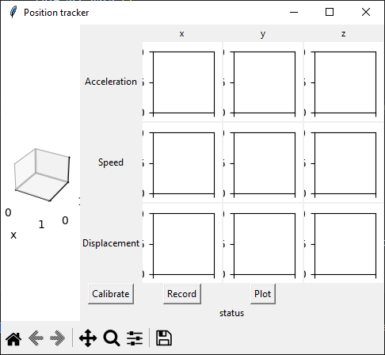
User interface
Status label
Individual acceleration, speed and displacement graphs for each axis
Dynamic map

Slide 6
Problem found
Accelerometer noise (double) integration
Imprecise orientation from gyroscope

Slide 7
Possible improvements
Longer calibration (limited solution)
Extra filtering
Sensor fusion
Fine tunning the parameters (threshold value and window size)
Decreasing the time interval between readings

Slide 8
References
Manon Kok, Jeroen D. Hol and Thomas B. Sch¨on (2017), ”Using Inertial Sensors for Position and Orientation Estimation”, Foundations and Trends in Signal Processing: Vol. 11: No. 1-2, pp 1-153. http://dx.doi.org/10.1561/2000000094
Implementing Positioning Algorithms Using Accelerometers (https://www.nxp.com/docs/en/application-note/AN3397.pdf)
Abyarjoo, F., Barreto, A., Cofino, J., & Ortega, F. R. (2014). Implementing a sensor fusion algorithm for 3D orientation detection with inertial/magnetic sensors. Lecture Notes in Electrical Engineering, 305–310. https://doi.org/10.1007/978-3-319-06773-5_41

